Slide 1
DDI-RDF Discovery Vocabulary _ Use Cases and Vocabularies
5th European DDI User Conference
04 December 2013, Paris, France
Thomas Bosch
GESIS – Leibniz Institute for the Social Sciences, Germany
thomas.bosch@gesis.org
boschthomas.blogspot.com
Notes:
Outline
-----
Constraint languages overview
Show OWL 2, DSP, ShEx example constraints (1. for each) using RDF Validator and ShEx demo
How to validate your data according to specific constraint languages?
How is SPIN connected to your data?
How to map constraint languages to SPIN?
Validation of all DSP and OWL 2 constructs (SPIN mappings)
Future work (validation of further constraint languages)
Extend your own constraint language
Build your own constraint language in 20 min

Slide 2
Notes:
Database on RDF validation requirements (URL)
Evaluation of constraint languages → use different CL for different use cases
Constraints can be expressed but not validated automatically
Constraint formulation
Constraint validation

Slide 3
Constraint Languages

Slide 4
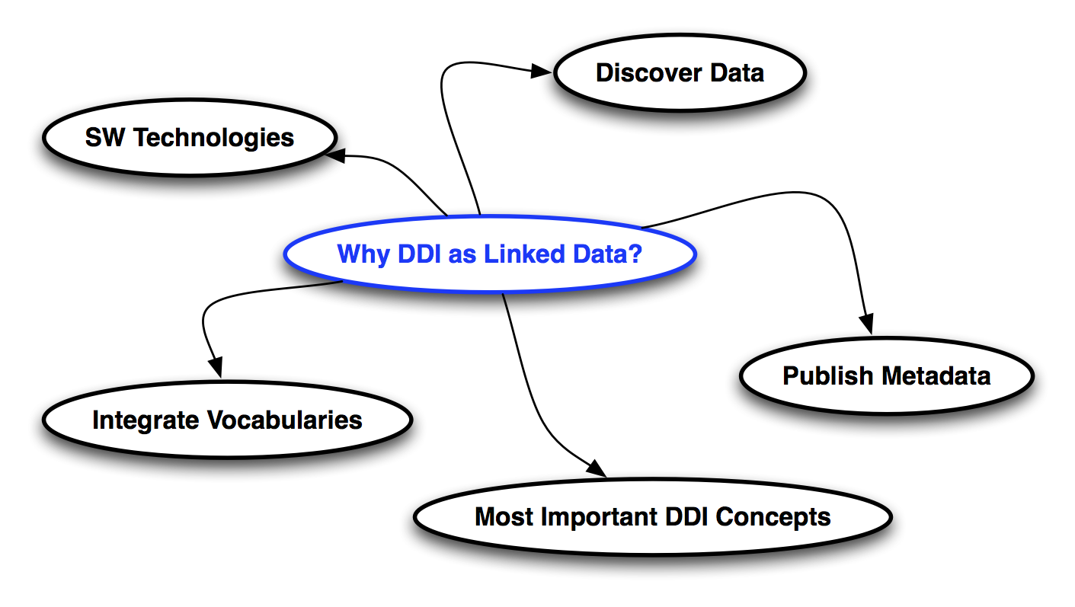
Why DDI as Linked Data?

Slide 5
Where to search for data?

Slide 6
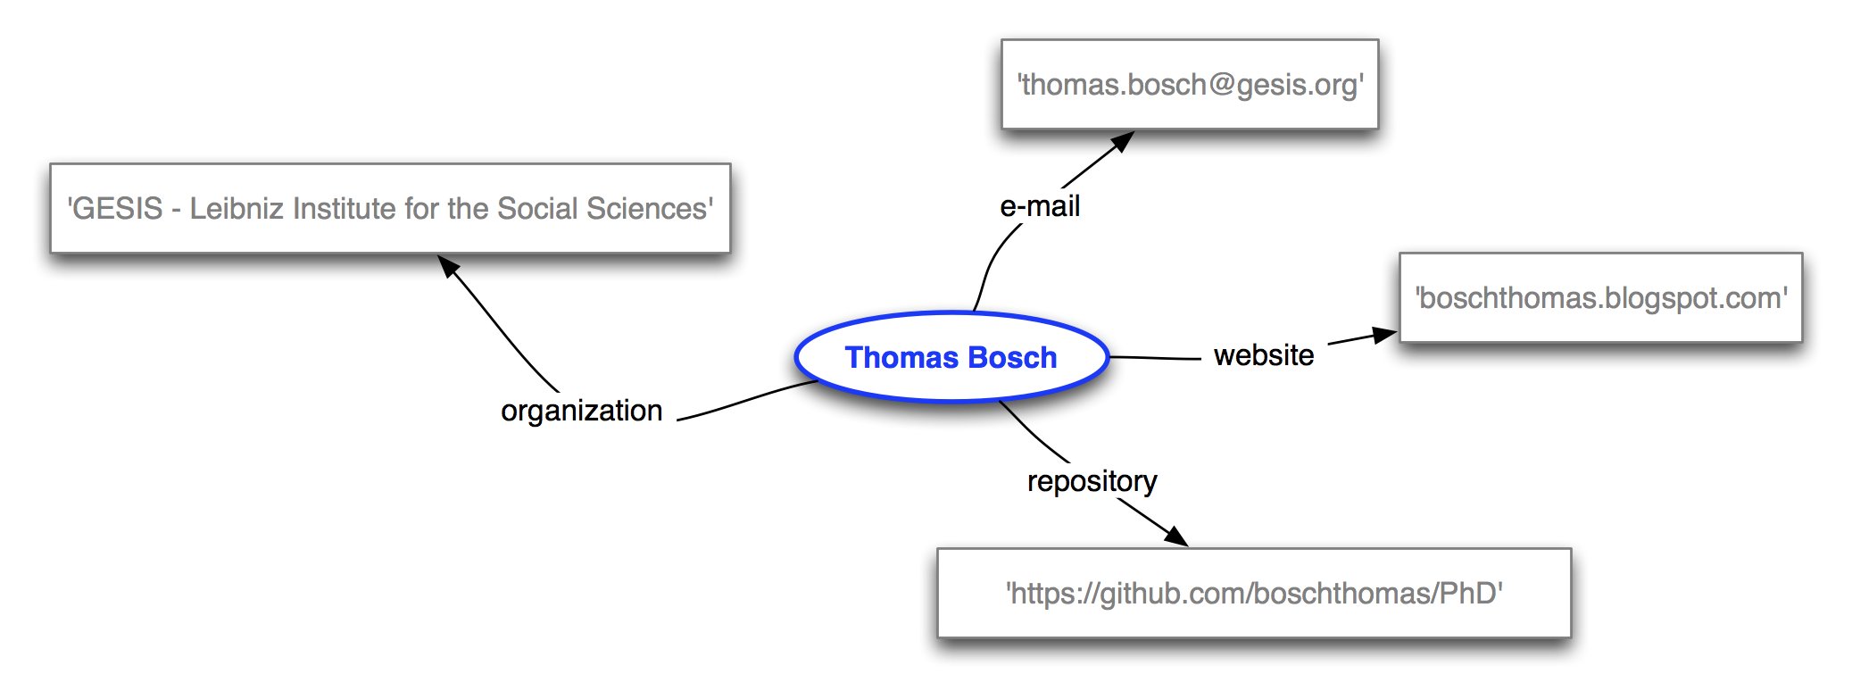
Thank you for your attention…

